Slide 1
Business Process Engineering
Introduction
Lecture: 02
Instructor: Salman Ahmad

Slide 2

What is BPE?
Notes:
Please explain?
Discuss the example of the Titanic and why the rafts were never thought of something else?

Slide 3
Need of Business Process Engineering
Rigid workflows
Perceived cost saving mechanism
Coordination between departments
Inability to see the solution hidden in plain sight

Slide 4
Does that mean …
Corporates perform badly?
The answer is No and Yes
The problems is beyond their control
Advancement in technology
Disappearing borders
Customer expectations change
Competitive advantage is changed

Slide 5
A look in the history
20th century marked as industrial Revolution
All manufacturing today roots back to a prototypical pin factory described in They Wealth of Nations in 1776 by Smith a Business Consultant
Principle of Labour Division
Some number of specialized workers, each performing a single step in the manufacture of a pin, could make far more pins in a day than the same number of generalists, each engaged in making whole pins
Notes:
10 man doing 1 or 2 jobs out of 16 can make in the upwards of 48,000 pins per day

Slide 6
1800s
1820s, the Rail Road revolution
Single track, collision mitigation
Their developed command and control mechanism was necessary to avoid trouble

Slide 7
Era of Ford and Solan
Henry Ford introduced the concept of moving assembly line
Each worker does one simple job
Overall job to complete a car become challenging
GM – Solan takes over after GM has offered too many models for the market
Solan created smaller, decentralized divisions that managers can oversee
Managers don’t need Engineering expertise and Executives need not worry about the management
Notes:
Solan applied division on labor on organization where as Ford applied it on manufacturing

Slide 8
1900s
Post WWII, the demand for thing was on the rise
New organizational model was developed and adopted quickly by Europe and Japan
Customer demand was huge post WWs and Great Depression
People would want any thing, any house and any car
Demand for quality was extinct
1960 – addition of white collar job resulted in more break down of tasks

Slide 9
Today
Nothing is predictable anymore
People demand quality of Product/service
Willing to pay premium for good user experience
Resource sharing and preservation is in demand

Slide 10
The inevitable
Corporates need to face the challenges
Cannot rely on predictable business cycle of growth – recession
Cannot predict profitability like it used to
Nothing is constant, customer demand, competition, rate of technology change
Notes:
Nothing is constant or predictable—not market growth, customer
demand, product life cycles, the rate of technological change, or the
nature of competition.

Slide 11
Three Cs, a new force
Customer
Competition
Change – the only constant

Slide 12
Example
Ford Motor
1980, great depression for auto industry, cost cutting was obvious
Estimated that Accounts division is 5 times bigger than it should be (500 employees)
Company started analyzing
Workflow identified as
When the purchasing department would write a purchase order, they sent a copy to accounts payable.
Then, the material control would receive the goods, and send a copy of the related document to accounts payable.
At the same time, the vendor would send a receipt for the goods to accounts payable.

Slide 13
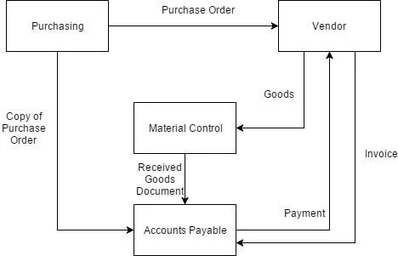
Example - continued

Slide 14
Example - continued
Ford
Updated the workflow as
Purchasing issues an order and inputs it into an online database.
Material control receives the goods and cross-references with the database to make sure it matches an order.
If there’s a match, material control accepts the order on the computer.
As a result the need for accounts payable clerks to match the orders was completely eliminated

Slide 15
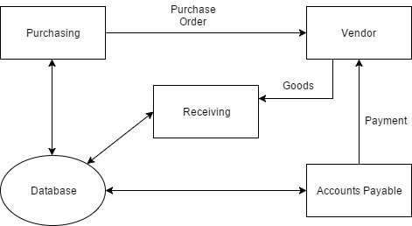
Example - continued

Slide 16
Can companies deliver?
Can companies based on 19th century ideas and principles will work today?

